Slide 1


Coding the Web - HTML
Connecting to the client App with JS
End to End Demo
Adding required node packages
Setting up node server
Client App
Querying
Events & Subscription

Slide 2
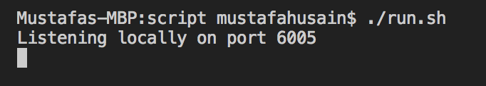

Slide 3
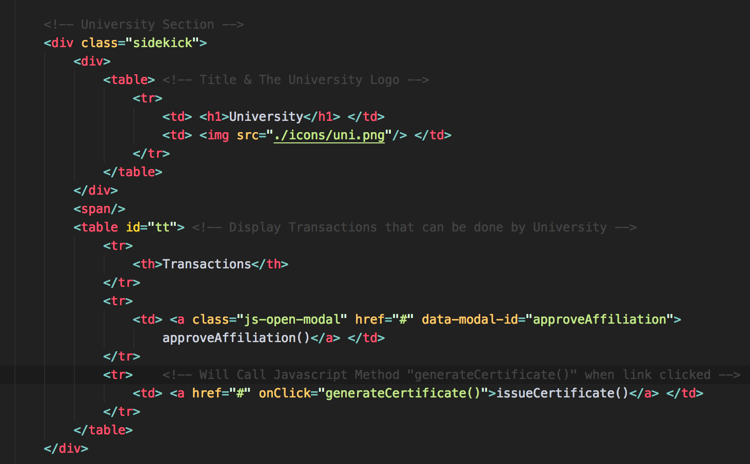
Defines One Section
OnClick action for invoking Transactions

Slide 4
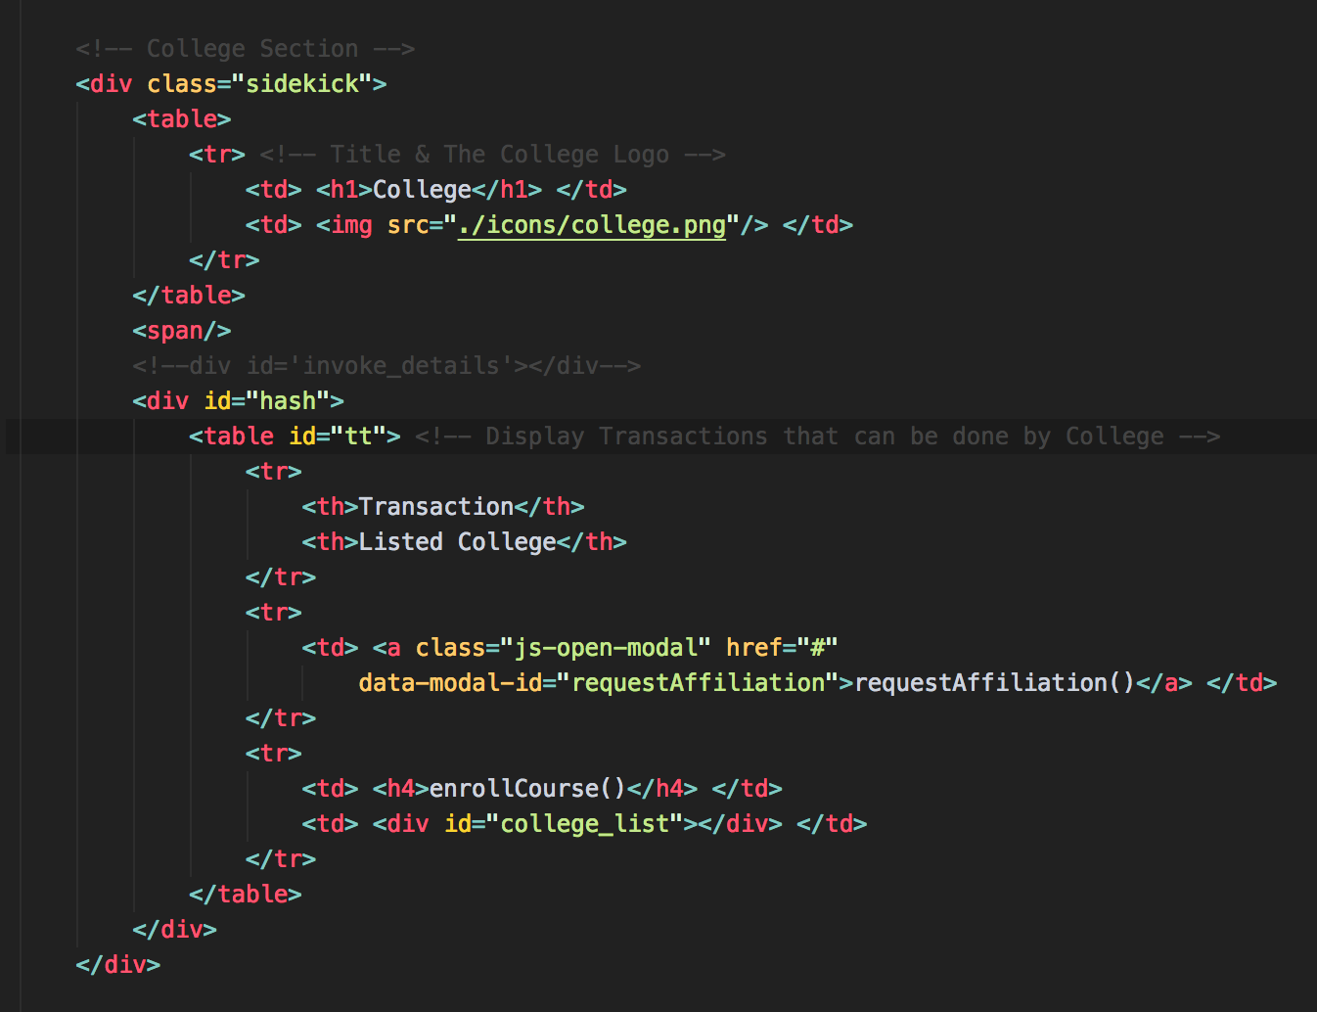
ID for Modal Dialog that will pop up onclick
College List will be dynamically generated & replaced in this division block

Slide 5
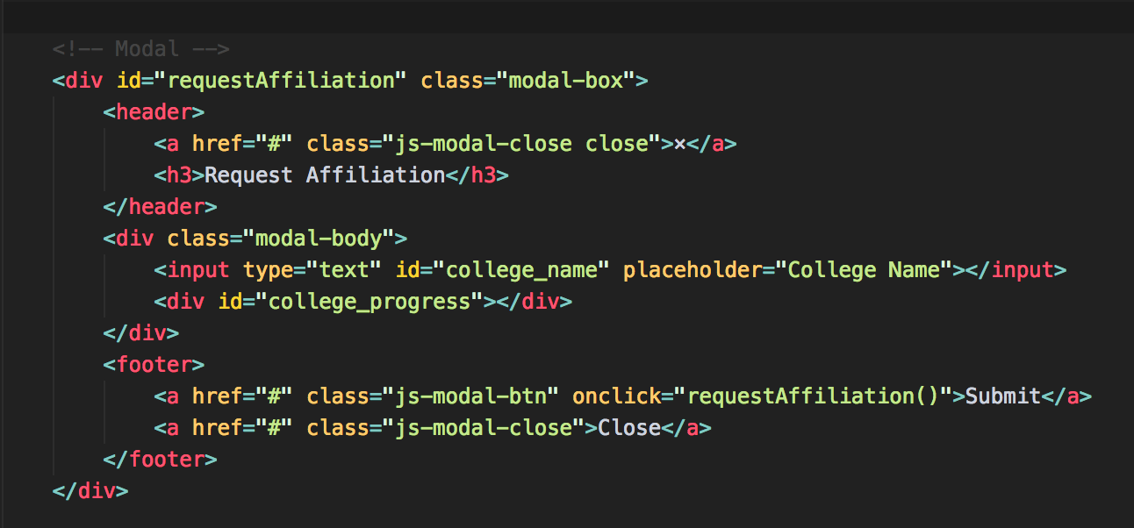
ID for Modal Dialog that will pop up onclick
Will be replaced by spinner image to show progress
Submit the Transaction

Slide 6
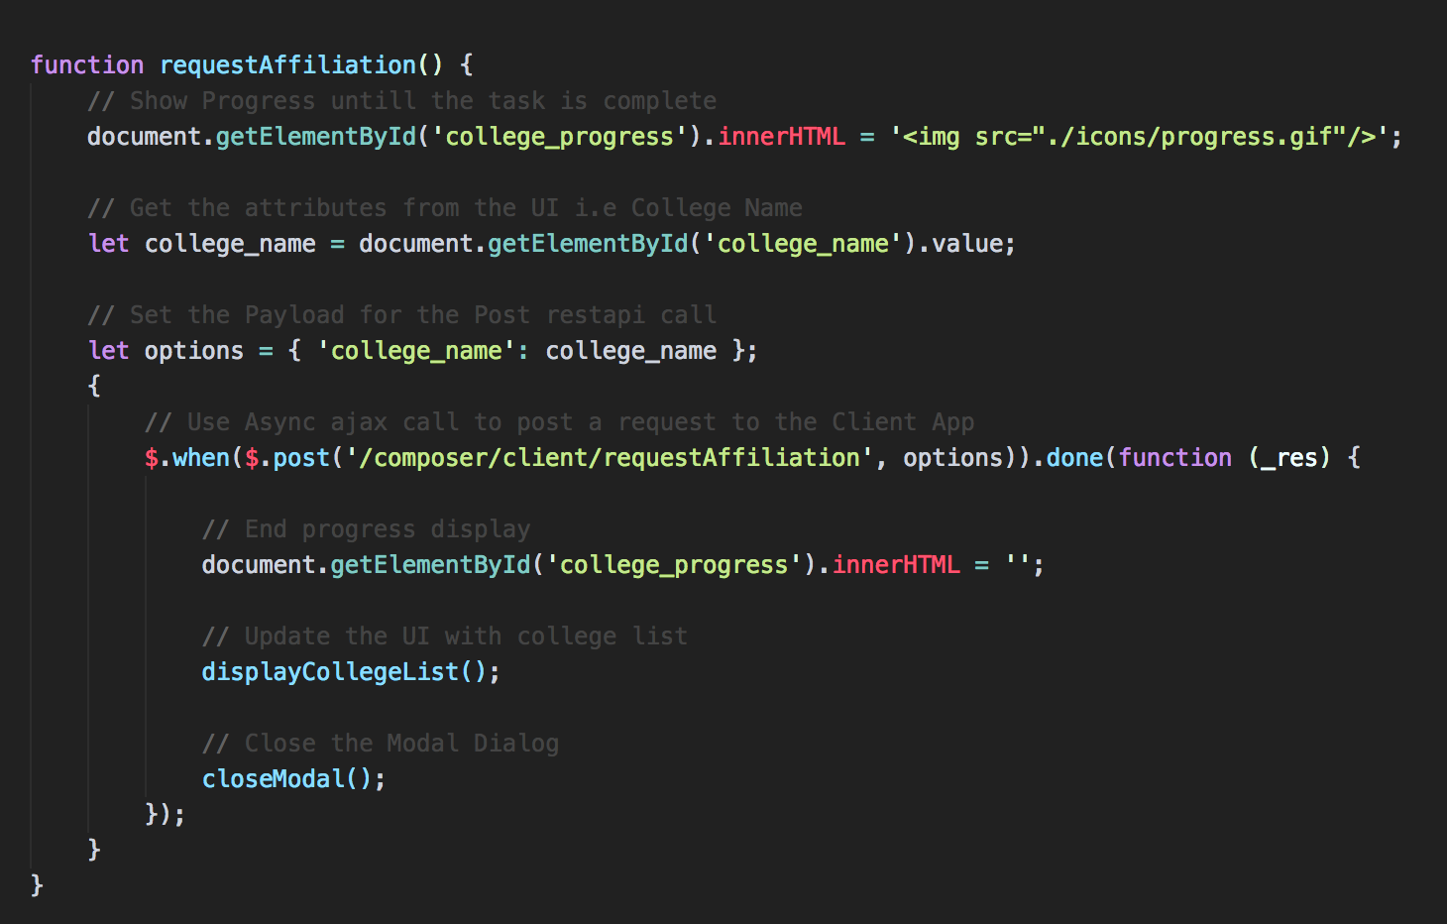
Will will setup router to call client app api in next Task

Slide 7
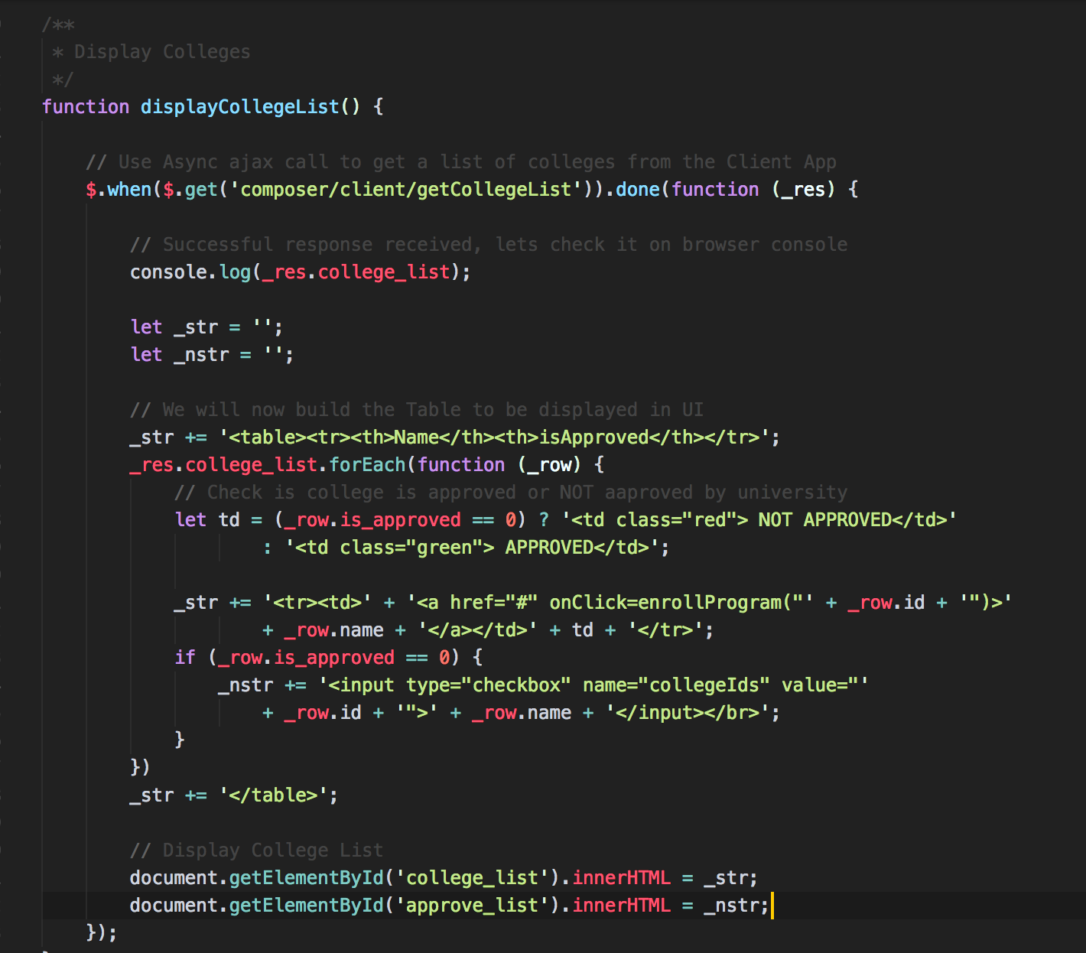

Slide 8
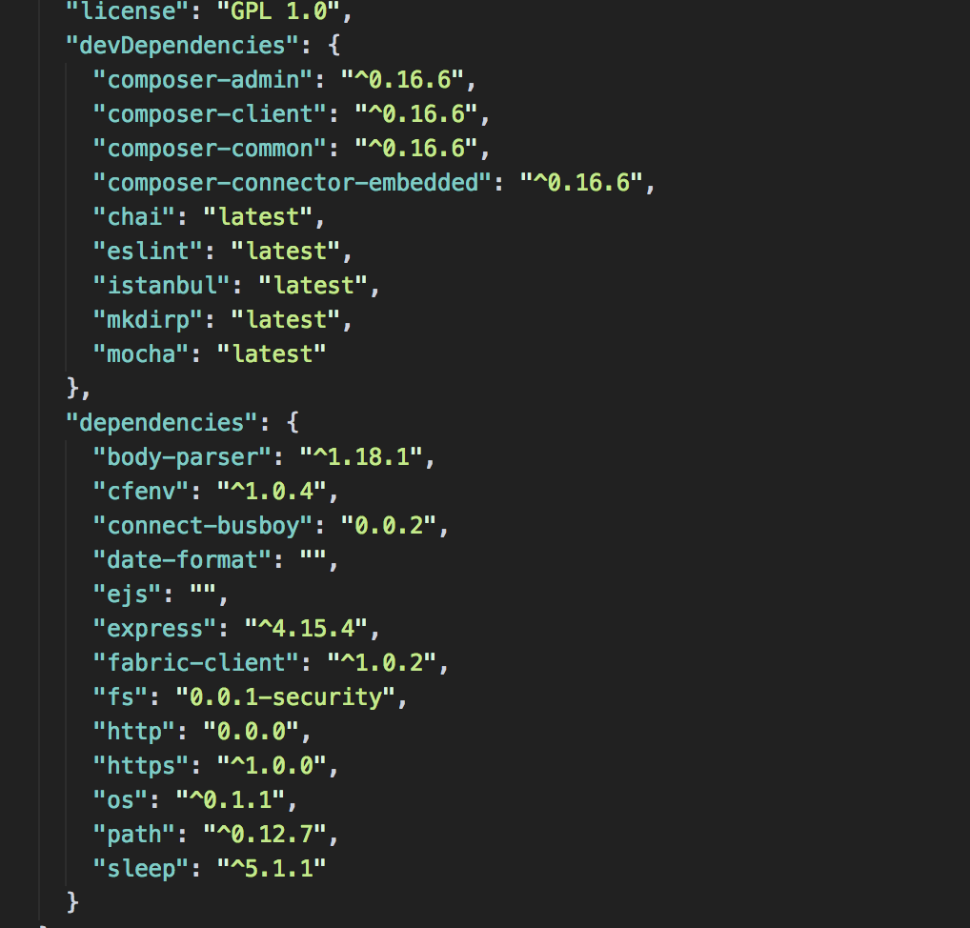

Slide 9
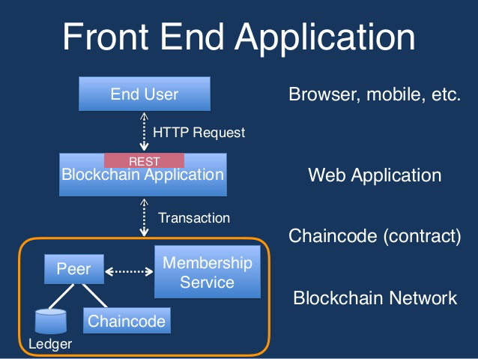
Custom Middleware

